Slide 1

CSE 547 - HW1
Quyen Tran

Slide 2
Overview
Hyperparameters tested using 4 folds CV:
Number of Layers:
1 layer with 1 node,
2 layers with 12 nodes and 4 nodes in each layer.
3 layers with 32 nodes, 32 nodes, and 16 nodes
Different Learning Rates:
0.1
0.001
0.00001

Slide 3
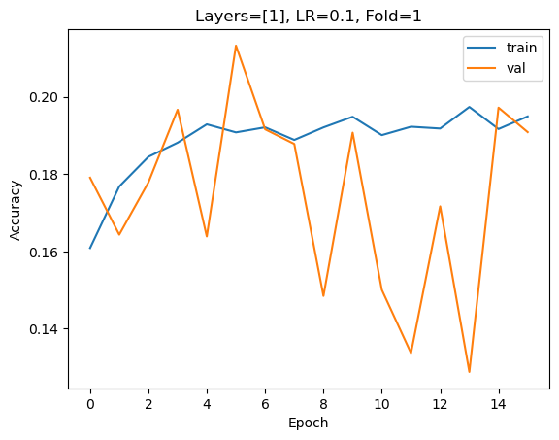
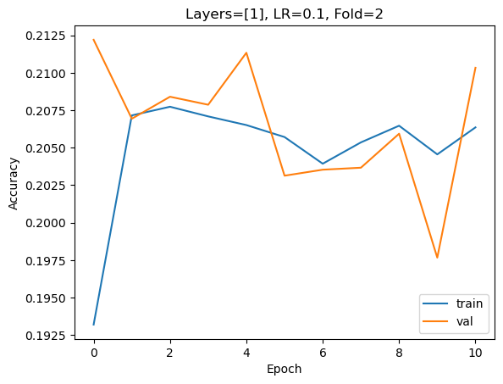
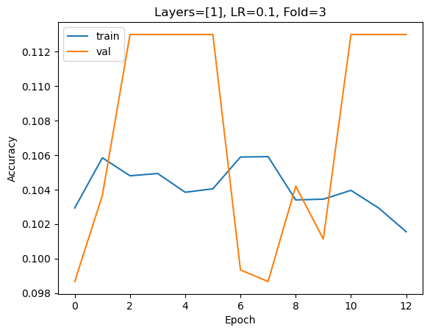
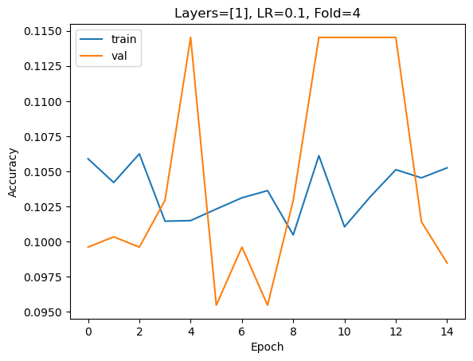
1Layer , LR 0.1
Across the four folds, the training and validation scores are random.
The model is underfitting because both the training and validation scores are low, a big indicator that the model is not actually learning the general pattern of the model.

Slide 4
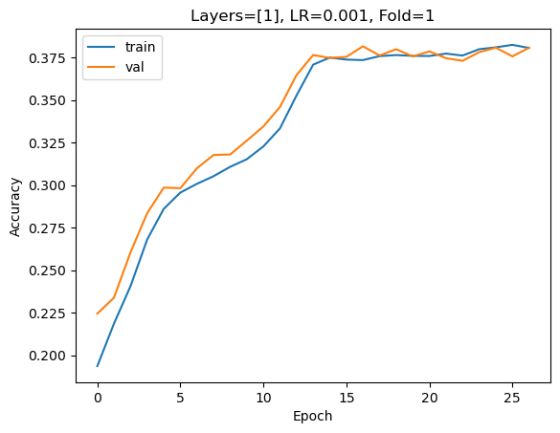
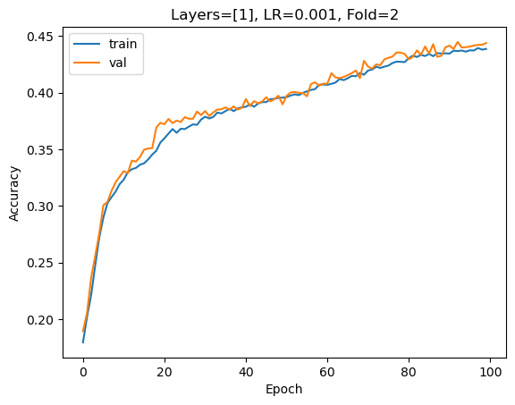
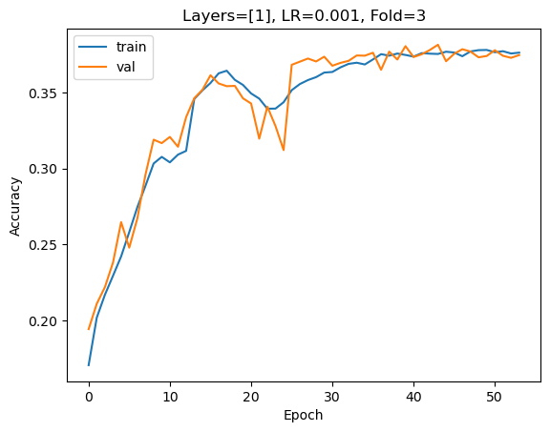
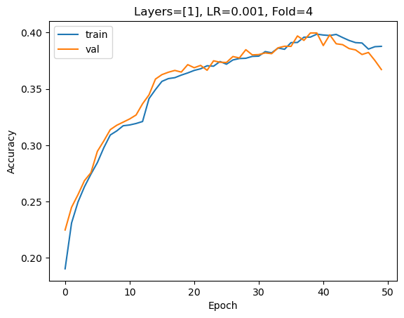
1Layer, LR 0.001
With a smaller learning rate, the training and validation scores seem less random as the training and validation scores are relatively close to each other
However, the model is still underfitting because both the training and validation scores are relatively low (but higher than the LR of 0.1)

Slide 5
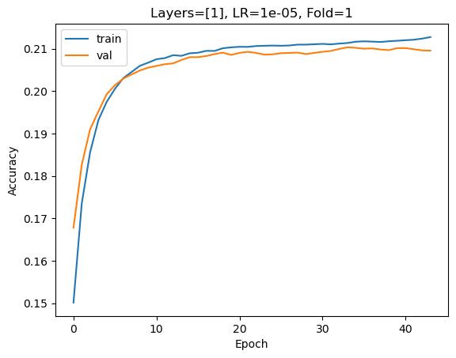
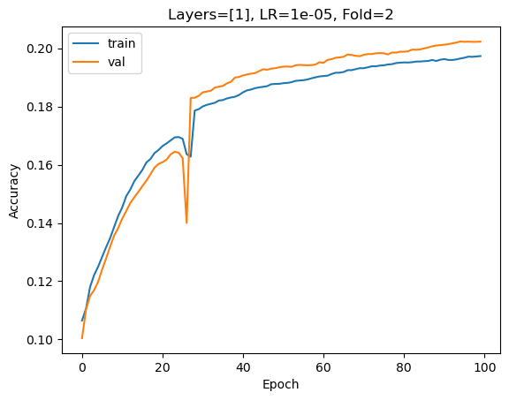
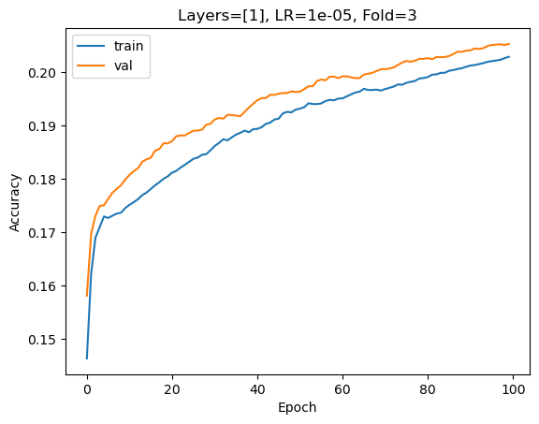
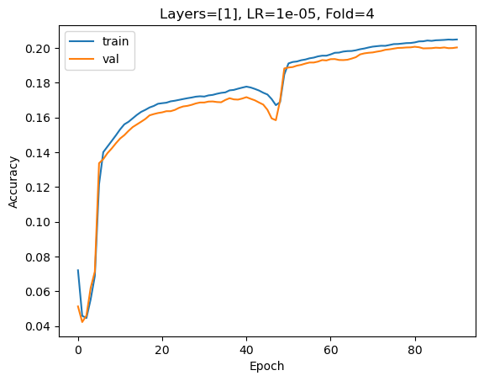
1 Layer, LR 0.00001
Lower training and validation accuracy with a lower learning rate of 0.00001
The model is still underfitting because both of the training and validation accuracy scores are still low.

Slide 6
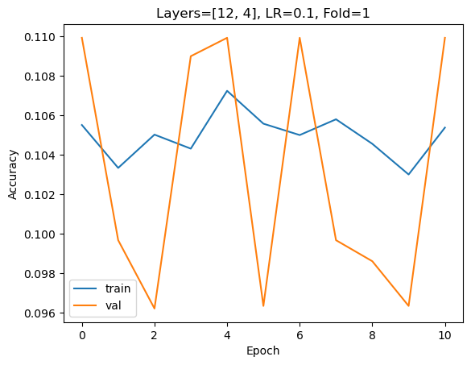
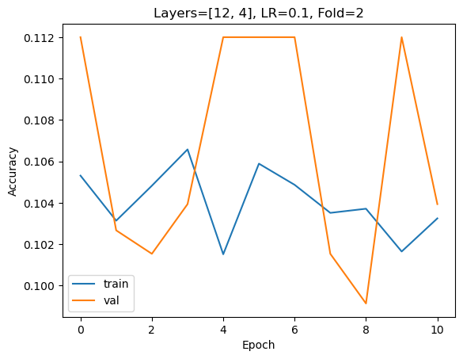
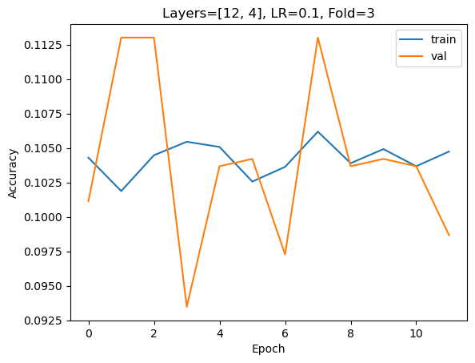
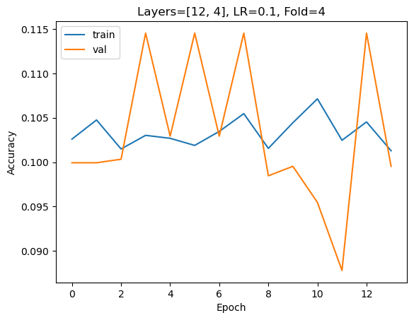
2 Layers [12,4], LR 0.1
Once again, a learning rate of 0.1, which seems too big, results in random training and testing scores
There is underfitting

Slide 7
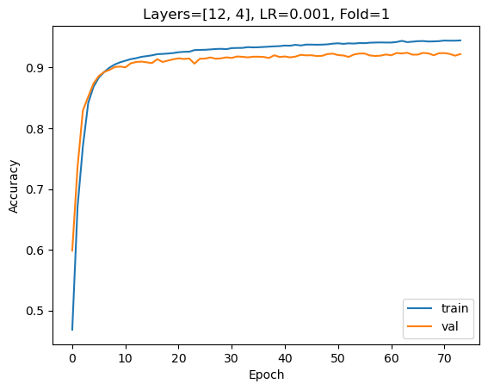
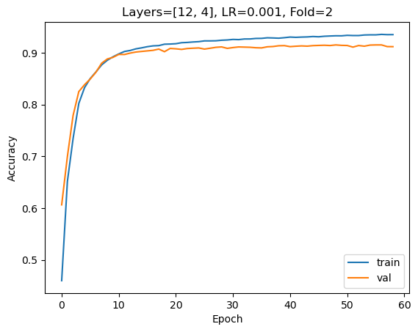
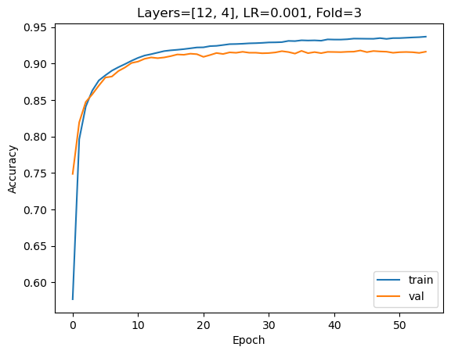
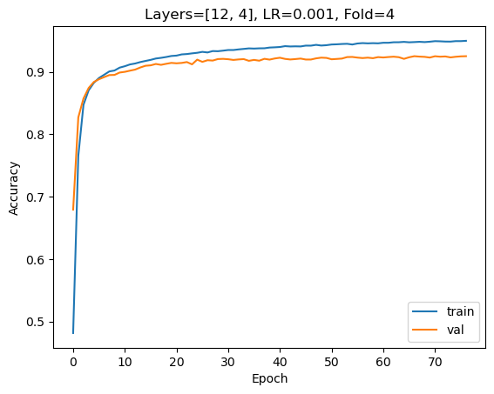
2 Layers [12,4], LR 0.001
Much better performance compared to the other hyperparameter combinations
Around epoch 10, the training and validation score are close and the scores are relatively high (0.90~), so I would say that it 's neither underfitting and overfitting.
​

Slide 8
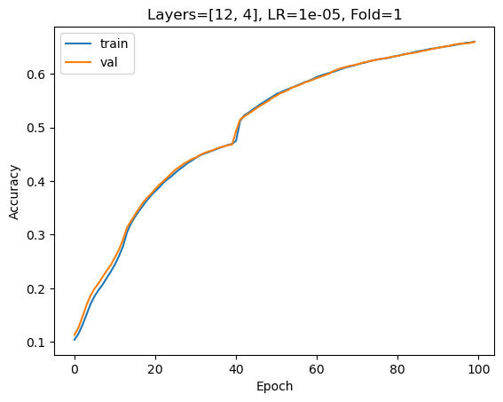
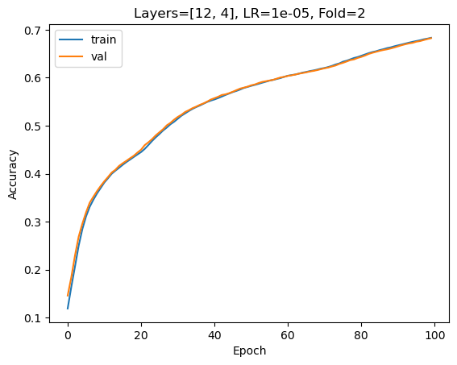
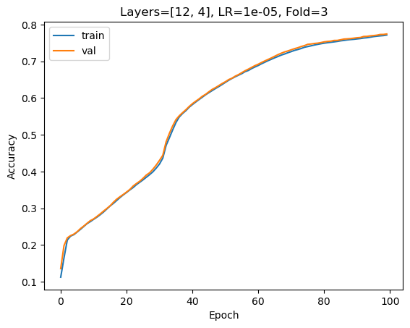
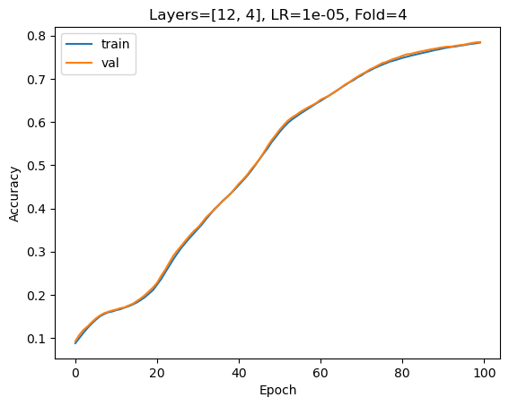
2 Layers [12,4], LR 0.00001
Learning rate is too low and the accuracy scores starts to diminish
Not the best model for this number of layers

Slide 9
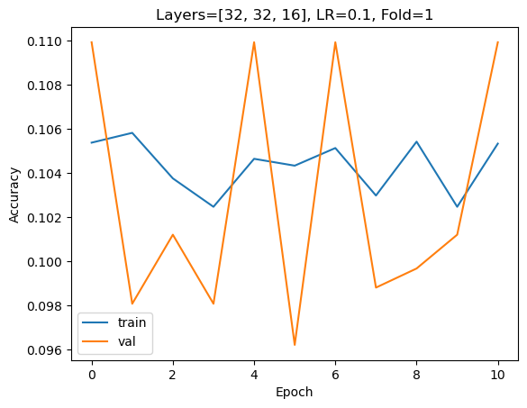
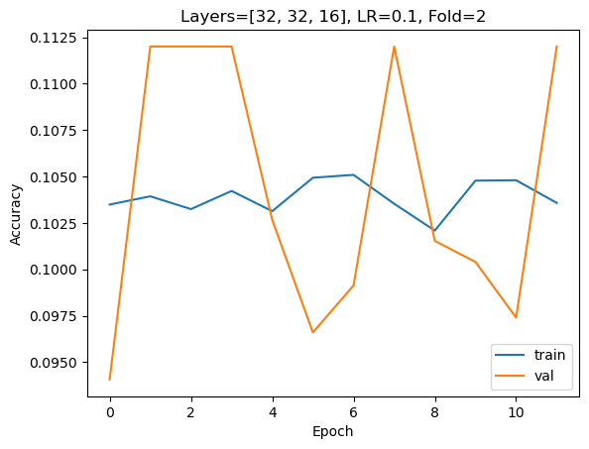
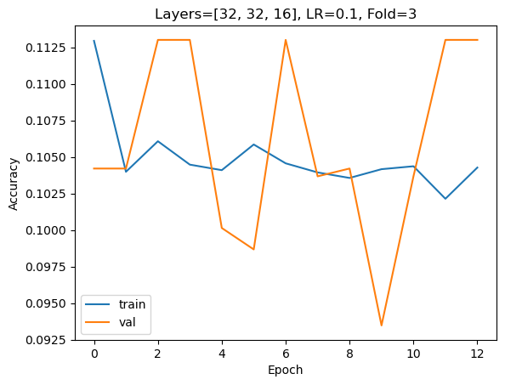
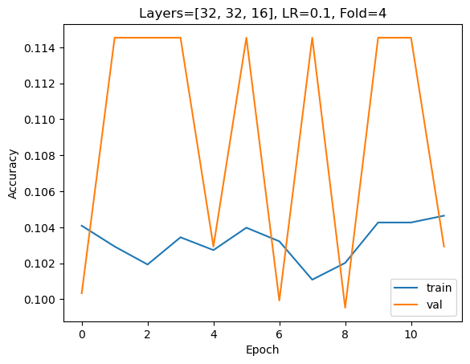
3 Layers [32,32,16], LR 0.1
The learning rate is too high and the training and validation scores are random.
The model is underfitting

Slide 10
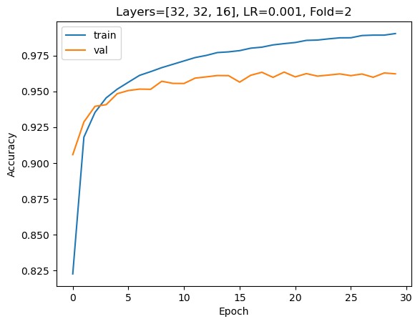
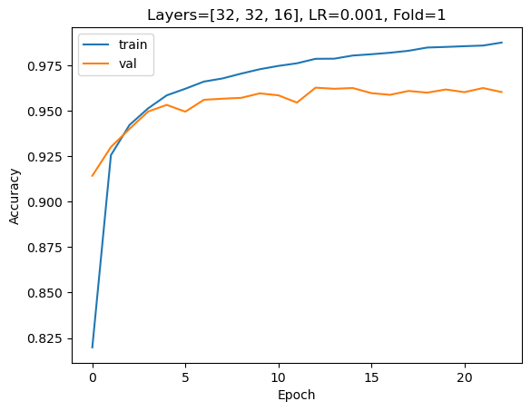
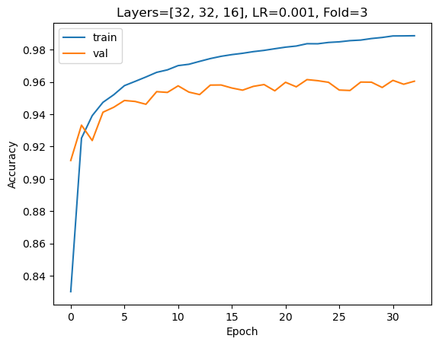
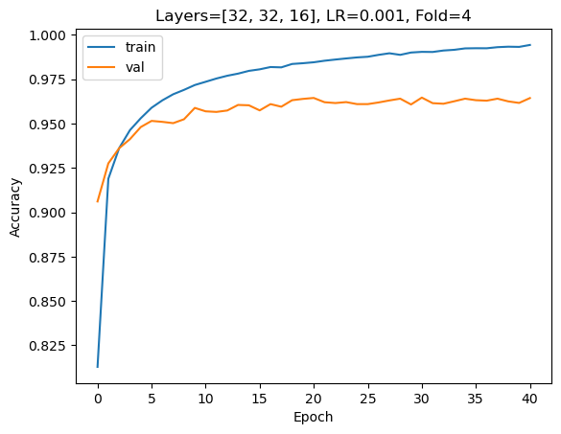
3 Layers [32,32,16], LR 0.001
This is the best hyperparameter
The model generalizes well and the training and validation scores are not far from each other, which would indicatethat it's not overfitting with the training score being around 0.95 and the validation score being around 0.975

Slide 11
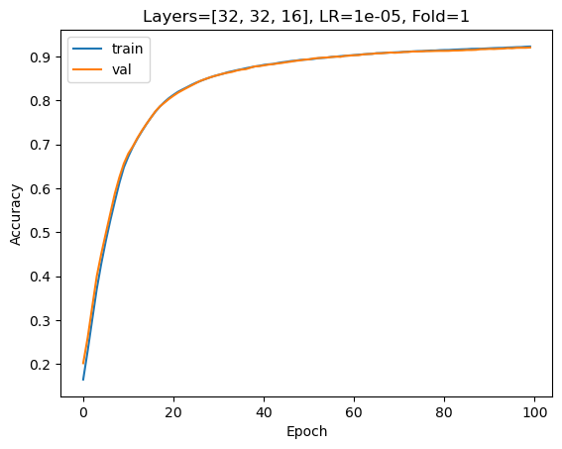
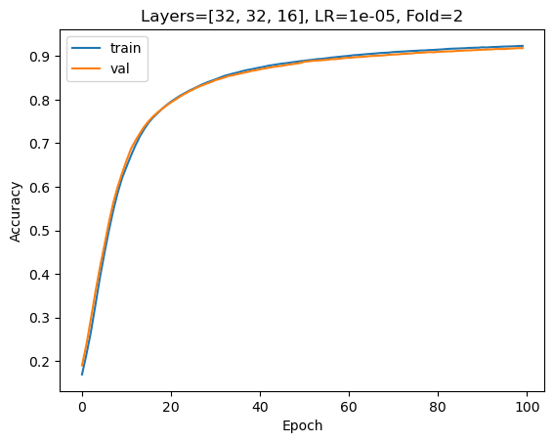
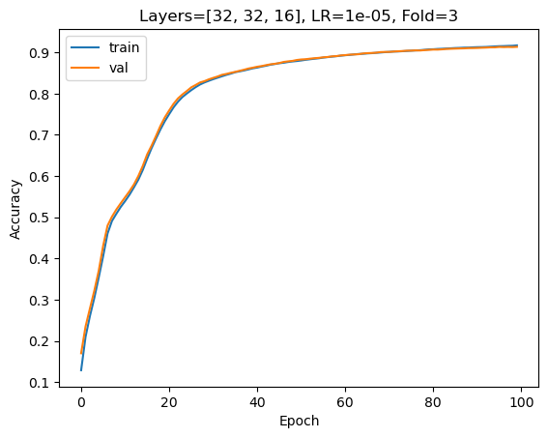
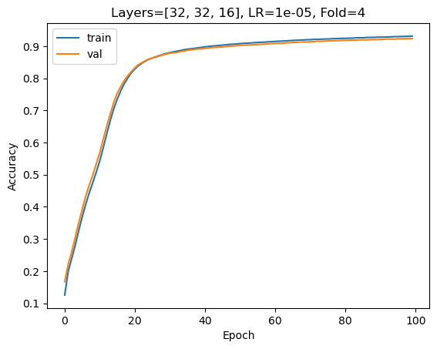
3 Layers [32,32,16], LR 0.00001
The model is less accurate with a lower learning rate
There is less chance of overfitting though because the training and validation score are super close to each other.

Slide 12
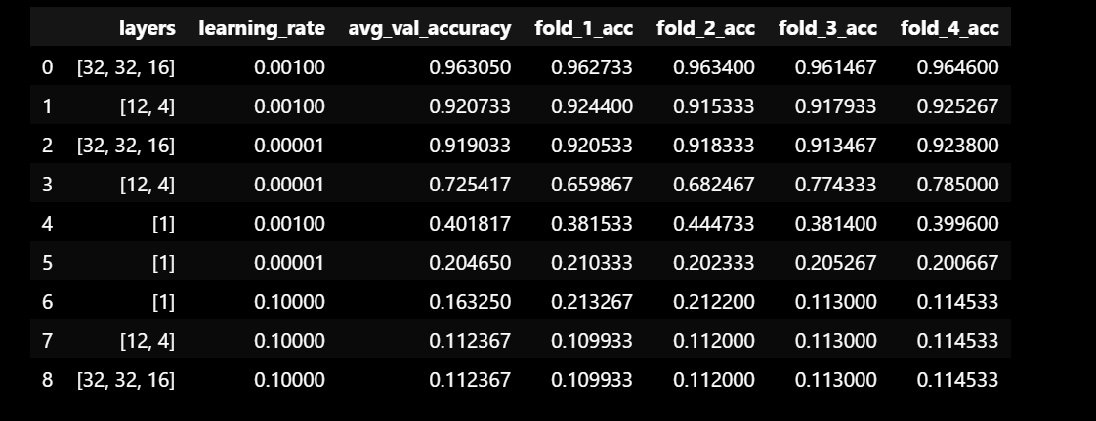
Top 3 Hyperparameter Combination (based on Average VAL Score)
Number 1: 3 layers [32,32,16] with a LR of 0.001 with average validation score of 0.96
Number 2: 2 layers[12,4] with a LR of 0.001 with average validation score of 0.92
Number 3: 3 layers[32,32,16] with a LR of 0.00001 with average validation score of 0.92

Slide 13
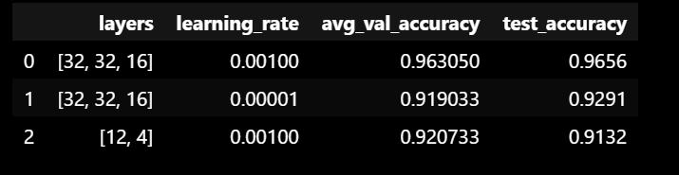
Predict on Test Data with top 3 selections
When comparing the average validation score versus the test accuracy, theyy are relatively similar, which is a good indication that the results were not random and the model generalizes well with the best hyperparameter combination being 3 layers [32,32,16) with a learning rate of 0.001.

